Slide 1

Category Strategy
July 2023

Slide 2
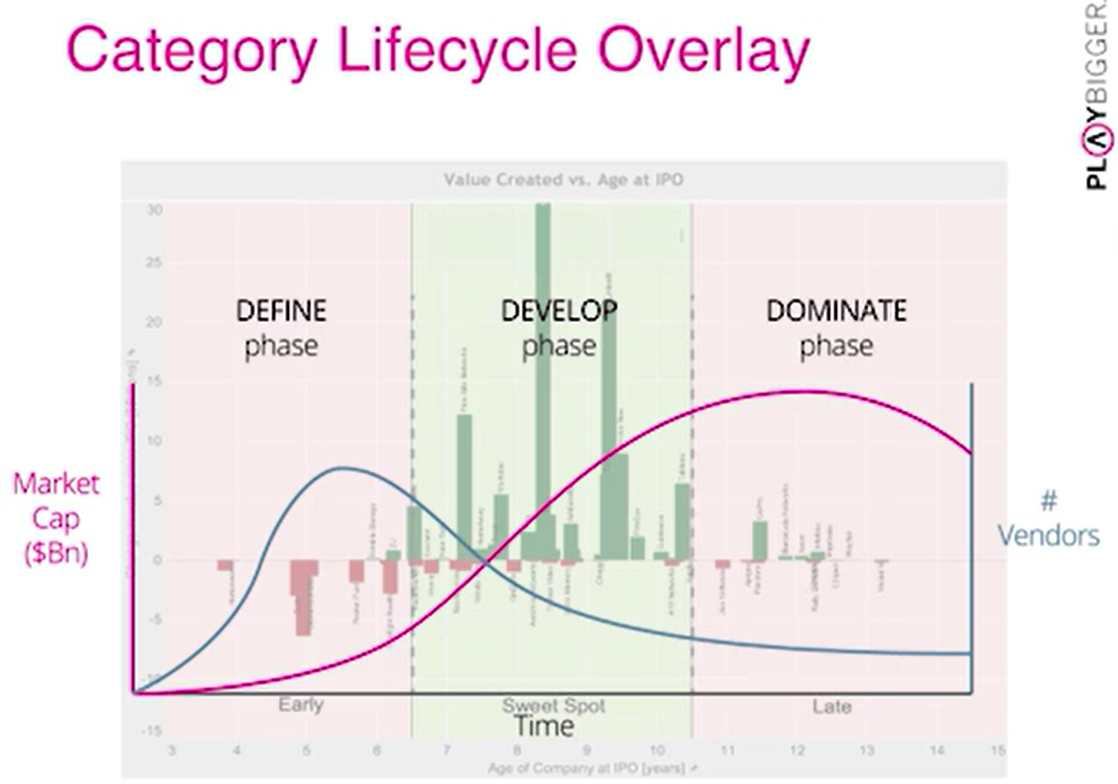
Category Design
Winner take all - 76%+ of any market category goes to the winner
Categories have a natural lifecycle - ~15 years to a final king
Years 6-10 are the height. This is where Kings are made and typically when they issue IPO
The develop phase of the category lifecycle is where value creation accelerates.
Categories aren’t stagnant

Slide 3
Categories: How They Work
People use categories to literally organize products/ideas in their brains
We like to have a filing system, put all the different brands and products in this system. This is how we identify categories.
When you walk into a supermarket you see category definitions above every isle. The store is organized by categories (mile in the back because most people need milk when they come in the store and have to pass the other categories to get to the dairy category section)
Our brains are overstimulated by everything coming at us. More than 50 cognitive biases push us to decisions not based on facts and logic, but on instincts. Three primary cognitive biases include:
Anchoring Effect: Early information effects all information that comes after
Groupthink: We believe things because other people do.
Choice Supportive: Once people choose a king they always tend to believe its better, even if its not.

Slide 4
Categories: How They Work

Slide 5
11 Facets of a Company
Vision Mission - product or market insight that led you to create the product
Customers - who are we targeting and who will use it
Problem statement - what’s the problem we can solve for potential customers
Use Cases - specific ways people will use product to solve their problem
Product Solution - detailed description of tech behind solution
Ecosystem - other companies involved in solving problem, where are control points of leverage
Competition - who’s trying to or will jump in to solve our problem
Business Model - how will product or service change business for customers
Sales and Go To Market - How will product go to market and how will they found out about our solution
Organization - How are decisions made, who are major influencers
Funding - what is next funding event? Runway before more funding needed? etc.
Notes:
Andy quick bio - why me, why now

Slide 6
The Three Questions
Can you explain the problem you are trying to solve like a five year old?
If your company solves this problem perfectly, what category are you in?
If you win 85% of that category, what’s the size of your category potential?
Notes:
Andy quick bio - why me, why now

Slide 7
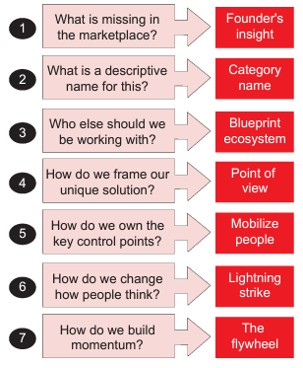
Category Design
Convert insight into a plan for a worthy category and craft language to shift the mindset and convince others to see things the way you do.
Identify the Problem
The Solution & Category Name
The Category Blueprint & Ecosystem
The Point of View
Lightning Strike Execution
Strike Ops Flywheel

Slide 8
Identify the Problem
Questions to Consider
Who is our audience now and in the future?
Current GR folks
General public
What is their problem?
Technology
Lack of overall tech investment in space
No tools are easy to use and all are outdated
Terrible UI experiences
Does not make your job easier
Affordability
Current services can only be accessed by the wealthy or large organizations
Access
Only wealthy and/or well-connected currently have influence/a voice
Knowledge & Understanding
Few have operational knowledge of legislative processes at state and local levels
Knowledge is critical in your ability to participate in and have influence on laws that affect you most
What are the day-to-day problem/s faced by our customers who track legislation for their job?
Why can’t some people more effectively advocacy or have their voice heard (Uvalde parents, trans advocates, etc.)?
How are their lives being negatively affected by the current solutions?

Slide 9
Why
Only a few wealthy and well-connected people have the political access to influence legislative policies that directly impact everyone’s community, career, and life.
Everyone should have affordable access to advanced legislative technology that provides each user with the knowledge and legislative details necessary to participate in the process in minutes.
Governments at every level are responsible to their voters AND their political donors. Technology and education can empower everyone to have influence and ultimately force governments to be more responsible to more of the people they represent.
Notes:
“Wealth in and of itself is not problematic. It is how rich people convert financial might into political power for their own benefit that creates problems.”

Slide 10
Identify the Problem: Points to Consider
It should generate a “that’s right” response from the person hearing it.
It needs to identify the problem itself, not a symptom of the problem.
It must always be the villain. It cannot be a “good guy” in other contexts.
It must not be so broad that it feels vague, abstract, or unsolvable.
It must not be so specific that we cut off future markets (local, public, etc)
It should be described in a way our customers talk about it.
It must be a problem our initial MVP actually solves.
The problem must cause our customers significant pain.

Slide 11
The Solution
Frame out MVP
Features
Specific technologies used
Add-ons
Benefits of MVP:
Saving you time
Increase quality of your work
Increasing your knowledge/understanding
Streamlined coordination and communication with your team/clients
Affordability
Access

Slide 12
Category Story & POV
Highlight the pain that your audience experiences from the problem we defined earlier - aim for the gut. Emotional appeal.
Demonstrate how current approaches to solving this problem don’t exist or are no longer adequate. Why the problem sucks.
Point to your new category as a new (and different) solution to solving this problem. Point to, but do not focus on the product. This is about selling the category, not the product. Create space our product will fill.
Create contrast between life before the category and what life will be like after the category
Cast a vision that can excite your customers, partners, and investors and serve as a north star for your company.
Strive for simplicity. Make them want to hear more about the story.
Tell the world why a new category needs to exist.
This can be a from-to narrative (POV)
Moving the world from a former state (that was causing pain) to a future state (where that pain is resolved)
Short narrative that shows the market what the world will look like once this new category is established.
Or we can consider a “strategic category narrative”
Create a narrative about the “new game” that the winners are playing (and why the old game is obsolete)
Winners address the problem this way and our product will help ensure you are a winner

Slide 13
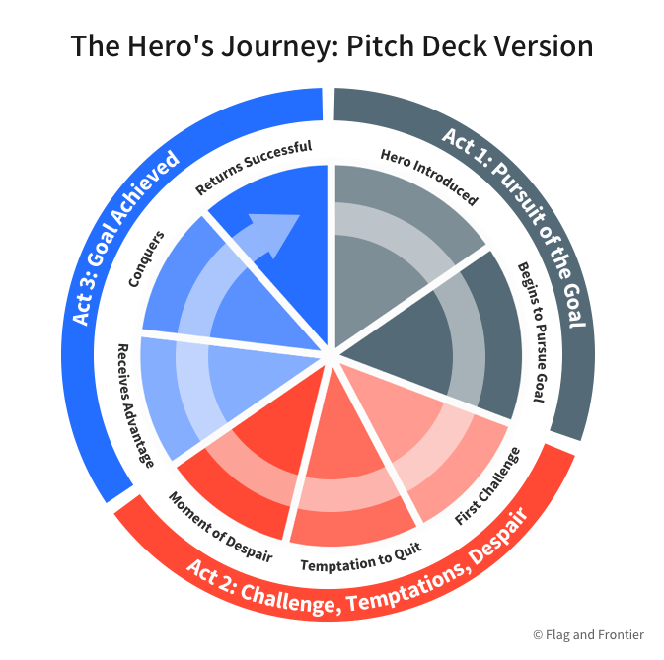
Category Story & POV: Points to Consider
The basic idea is that a story’s hero is faced with a disruptive change to his world. The only way he can conquer this change is through some externally granted power. Once he wields this power, he’s able to surmount these challenges and return to a restored world that’s better than the one he left.
Act One: The hero is pursuing some goal or dream.
Act Two: The hero faces challenges, temptations and setbacks that prevent him from reaching this goal.
Act Three: An external force intervenes to give the hero a special advantage. The hero conquers all obstacles and succeeds.

Slide 14
Point of View
Who is the bad guy?
Not just Telicon
Put a name to the bad guy.
Who is the good guy?
Not our product…the category

Slide 15
Category Name
A short phrase that gives the category a reference point. It’s main job is to point our audience’s thinking in the right direction. Serves as a new phrase for a conversation starter for new category.
Avoid a category name that’s so broad that it could apply to a number of different problems and solutions. Something too similar may be written off as something your audience “already knows about.” But something too foreign may be too difficult to grasp.
Consider whether the category name should build upon familiar terms or be entirely new.
Make sure the category name isn’t already used in another context.
The category name should be something that can stick in your mind and be pleasant to say.
Your category name doesn’t have to be perfect. It’s unlikely everyone on your team will agree on it. If it’s close enough, then move on. It may also morph over time. Listen to the market – if it changes it to an acronym, use the acronym. If it changes a word, adapt.

Slide 16
Market Insight
The global software as a service market size is expected to reach USD 819.23 billion by 2030, growing at a CAGR of 13.7% from 2023 to 2030.
The rising trend towards mobile applications such as emails, video calls, and instant messaging further increases the usage of smart devices which further encourages the demand for software as a service (SaaS) during the forecast period.
The software segment led the market in 2022, accounting for over 84% share of the global revenue owing to a rise in the demand for cloud-based software outsourcing and an increase in the number of SMEs outsourcing
The private cloud segment held the largest revenue share of over 44% in 2022. Private clouds combine many advantages of cloud computing, such as ease of service delivery, scalability, security, elasticity, and resource personalization of on-premises infrastructure
The large enterprises segment led the market in 2022, accounting for over 60% share of the global revenue. SaaS gives enterprises greater visibility and control over their cloud environments, allowing them to manage risk and compliance requirements better
North America accounted for the largest share of over 44% of the global SaaS market. Software as a Service (SaaS) is a rapidly growing industry in North America, with many developments emerging in recent years. Cloud-based software solutions have become increasingly popular in North America due to their scalability, cost-effectiveness, and ease of use
Notes:
“Wealth in and of itself is not problematic. It is how rich people convert financial might into political power for their own benefit that creates problems.”

Slide 17
Lighting Strike

Slide 18
Technology Insight
Notes:
“Wealth in and of itself is not problematic. It is how rich people convert financial might into political power for their own benefit that creates problems.”

Slide 19
Category Potential
Notes:
“Wealth in and of itself is not problematic. It is how rich people convert financial might into political power for their own benefit that creates problems.”

